Slide 1
BUZZ vs. BITE
An Analysis of Alcohol Content and Bitterness in American Craft Beers
Peter Flaming | Matthew Trevathan | Quinton Nixon | Brock Friedrich

Slide 2
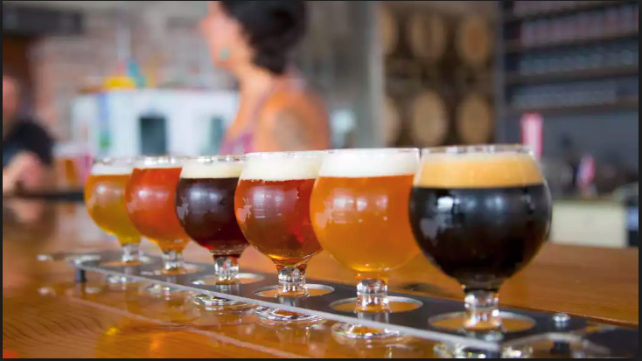
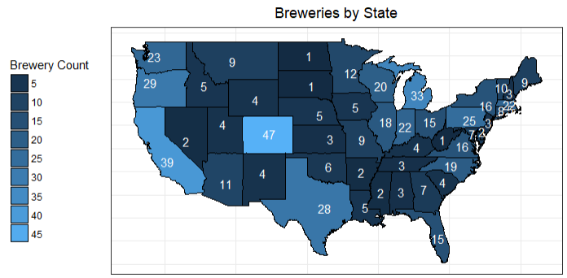
Introduction
Tasked by private equity firm looking to devote significant capital into the American craft brewing industry.
Scope of Analysis
Provide insights into:
Current market landscape
Regionality & geographical trends
Relationships of key beer characteristics
Page 2
Notes:
Matthew
Looking to understand the current landscape of the industry
Examples:
Doesn’t know customer demands/preferences
Types of popular beer would be high in demand.

Slide 3
Data Overview
Source
Wrangling
558 breweries
2410 unique craft beers
Spans across U.S.
Key beer features:
ABV = Alcohol by Volume (%)
IBU = International Bitterness Units
3% of records contained errors
Standardized location inconsistencies
Normalized beer and brewery names
> 50% of total effort
Median ABV and IBU
Page 3
Notes:
Brock
What data are we working with?
We are attempting to answer questions that will help narrow your focus in the evaluation of a new market
Focusing on the listed levels of alcohol by volume (ABV) and the international bitterness unit (IBU).

Slide 4
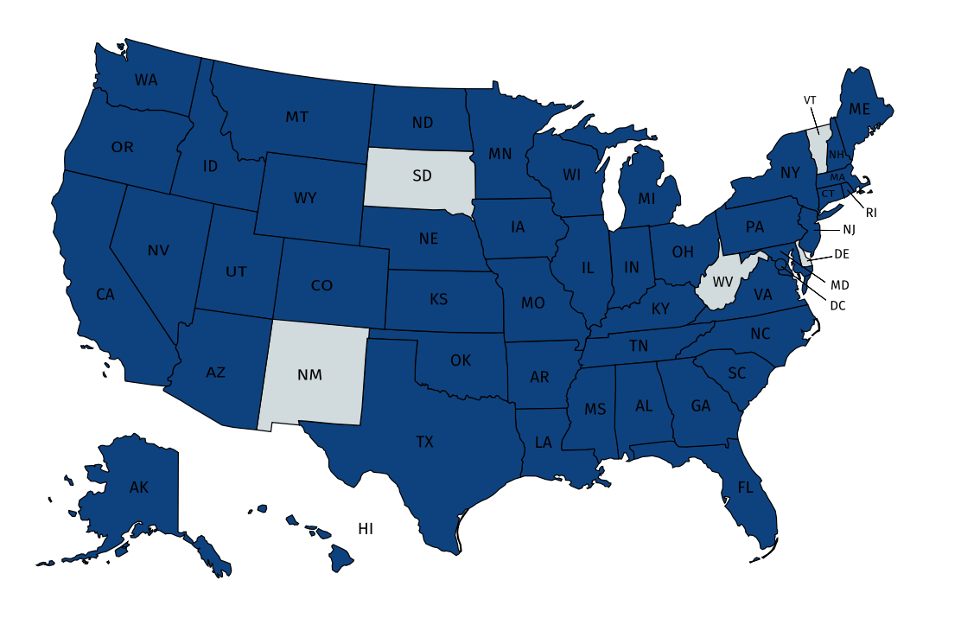
Craft Beer Style: Promising Market Expectation
Craft Beer Characteristics
Questions
Key beer features of style:
Variation of ABV and IBU
Geographical representation
Production and Distribution
What trends are hidden within the data?
Geographical trends?
Are there dominant States?
Potential Market Venture States
Number of breweries per state with production and distribution of key beer features of style:
Map of Market Ventures for 0.050 ABV
AK:3
AL:1
AR:1
AZ:3
CA:10
CO:12
CT:3
DC:1
FL:5
GA:1
HI:1
IA:3
ID:2
IL:4 IN:3 KS:2 KY:1 LA:3 MA:4 MD:2 ME:2 MI:8 MN:3 MO:3
MS:1 MT:3 NC:4 ND:1 NE:1 NH:1 NJ:1 NV:1 NY:1 OH:6 Ok:1 OR:8
PA:5 RI:1 SC:1 TN:1 TX:5 UT:2 VA:2 WA:2 WI:7 WY:2
2
3
1
3
8
2
7
1
2
8
3
4
2
1
3
5
1
12
4
3
6
2
10
2
3
1
1
3
1
1
4
States that have potential Market Ventures
1
1
1
3
1
1
3
5
5
1
ABV = Alcohol by Volume (%) | IBU = International Bitterness Units (IBU)
Page 4
Notes:
Peter
We are providing quantitative and descriptive statistics to answer questions that will help narrow the focus in the evaluation of a new market venture for our client.
Focusing on the listed levels of alcohol by volume (ABV) and the international bitterness unit (IBU) provided by the data gathered, we will utilize an appropriate linear model to draw statistical conclusions on the domestic beer market by the goodness-of-fit statistics of the ABV, and IBU correlation and the resulting coefficient of determination R².
The first quartile(Q1) is represented by beers with a 0.050 ABV value represented by the -American -IPA and -Ale styles of beer that ranges from 5-100 in IBU. There are 38 different styles of beers with this ABV, that are produced by 141 different breweries in 46 different states
The use of a 0.050 ABV for a beer will allow for a large amount of variation with respect to the IBU of a beer style. The use of an ABV of 0.050 with any IBU between 5-100 will likely be a highly demanded beer by the consumer market.

Slide 5
Conclusions
Strategic decisions should not be based on ABV and IBU.
Craft beer popularity seems to concentrate trend upward toward the coasts.
“Popularity” of a craft style was proxied by its occurrence frequency at breweries. Conclusions drawn through this proxy should be conservatively interpreted.
Oregon (0.128)
Colorado (138)
Correlation Analysis
Strong evidence of positive correlation
IBU rating accounts for ~45% of variation in ABV*
Relationship has low predictive significance
 | IBU | ABV
Count | 1413 | 2363
Min | 4 | 0.001
Max | 138 | 0.128
Mean | 42.8 | 0.0597
Median | 35 | 0.056
Stdev | 25.9 | 0.0135
NA | 1012 | 62
*p-value < 0.001 from a Spearman Rank-Correlation test | rho = 0.667
Page 5
Notes:
Quinton
Quantify relationship between IBU and ABV
Strategic decisions should not be based on ABV and IBU
Because of : many outliers, wide variation, relatively weak association

Slide 6

Questions
Page 6
Notes:
Quinton

Slide 7
Appendix
Project Repository: https://github.com/la-mar/DDS_Case_Study_1/
ABV = Alcohol by Volume (%) | IBU = International Bitterness Units (IBU)
Page 7
Notes:
Quinton

Slide 8
Appendix
Project Repository: https://github.com/la-mar/DDS_Case_Study_1/
ABV = Alcohol by Volume (%) | IBU = International Bitterness Units (IBU)
Page 8
Notes:
Quinton

Slide 9
Appendix
Project Repository: https://github.com/la-mar/DDS_Case_Study_1/
ABV = Alcohol by Volume (%) | IBU = International Bitterness Units (IBU)
Page 9
Notes:
Quinton

Slide 10
Appendix
Project Repository: https://github.com/la-mar/DDS_Case_Study_1/
ABV = Alcohol by Volume (%) | IBU = International Bitterness Units (IBU)
Page 10
Notes:
Quinton

Slide 11
Appendix
Project Repository: https://github.com/la-mar/DDS_Case_Study_1/
ABV = Alcohol by Volume (%) | IBU = International Bitterness Units (IBU)
Page 11
Notes:
Quinton

Slide 12
Appendix
Project Repository: https://github.com/la-mar/DDS_Case_Study_1/
ABV = Alcohol by Volume (%) | IBU = International Bitterness Units (IBU)
Page 12
Notes:
Quinton

Slide 13
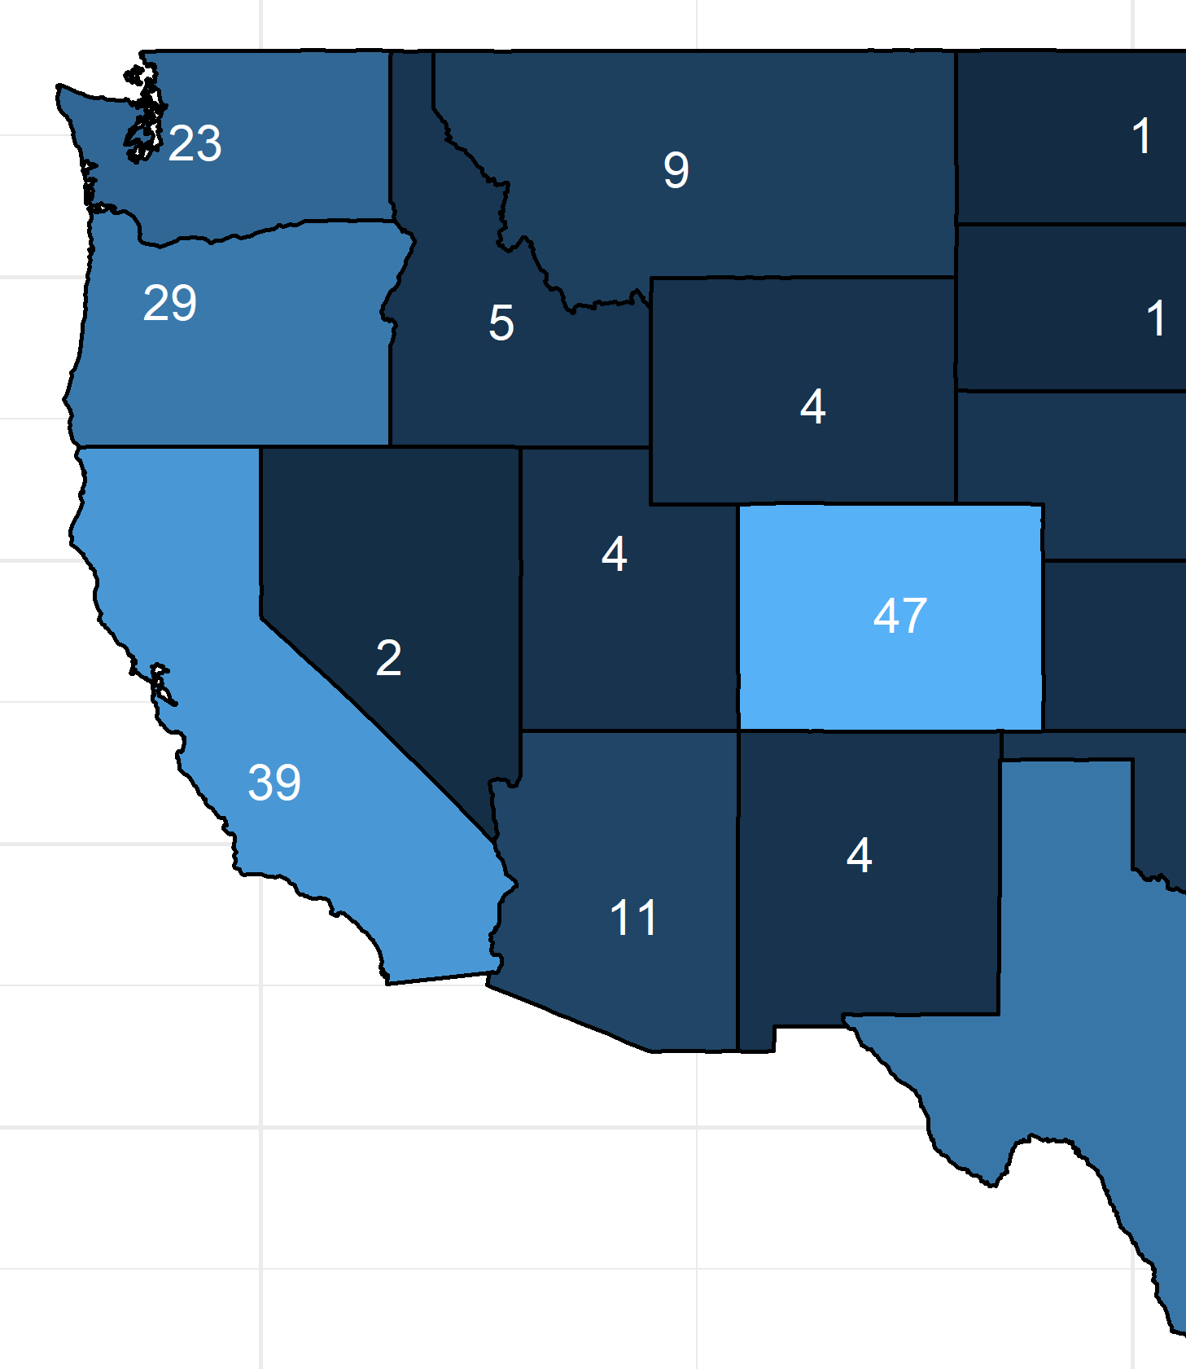
Setup and Process
Data Wrangling
3% of records contained errors
Standardized locaion inconsistencies
Normalized beer and brewery names
Analysis
Quantify relationship between IBU and ABV
 | IBU | ABV
Count | 1413 | 2363
Min | 4 | 0.001
Max | 138 | 0.128
Mean | 42.8 | 0.0597
Median | 35 | 0.056
StDev | 25.9 | 0.0135
NA | 1012 | 62
 | State | Value
Max IBU | OR | 138
Max ABV | CO | 0.128
ABV = Alcohol by Volume (%) | IBU = International Bitterness Units (IBU)
Page 13
Notes:
Brock
Understand significance of ABV and IBU relationship

Slide 14
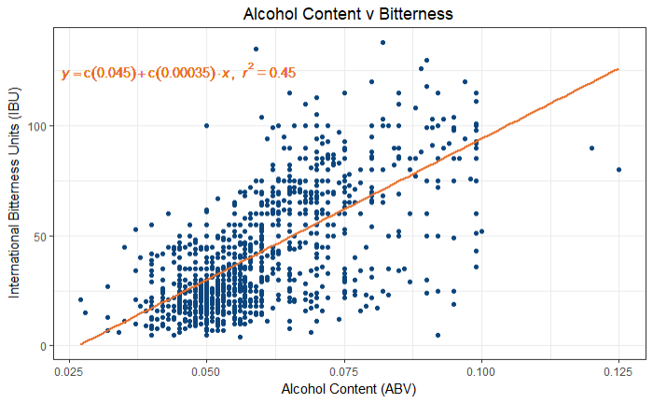
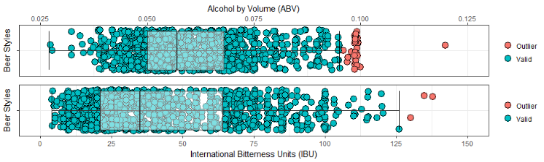
Why Study American Craft Beer
To understand the “lay of the land”
To identify popular beer markets
To find the ”magic formula”
Page 14

Slide 15
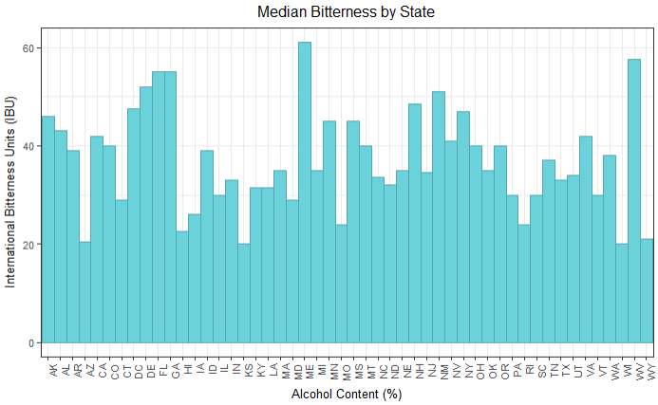
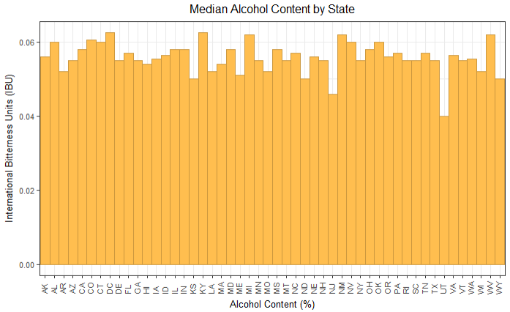
How did we do this?
Gather the data
Clean the data
Explore the data
Analyze the data
 | State | Value
Max IBU | OR | 138
Max ABV | CO | 0.128
Page 15

Slide 16
Appendix
Question 1
To determine the number breweries in each state we simply count the number of times each state appears in the table.
The prominent brewing states with twenty or more breweries include: Colorado 47, California 39, Michigan 32, Oregon 29, Texas 28, Pennsylvania 25, Massachusetts 23, Washington 23, Indiana 22, Wisconsin 20.
These prominent brewing states are important to the beer market, because of their distinct beer types and styles that are produced in state and consumed nationally.
What kinds of beers and their characteristics will be of great interest for the analysis.
Page 16

Slide 17
Appendix
Question 2
In data science, like in life, sometimes less is more. Instead of maintaining separate tables for breweries and beers, it’s helpful to merge the two datasets into a single combined dataset.
We do this by joining the two tables by the Brew_ID variable to create a new object variable named merged_data, which allows us to view the desired characteristics of beers produced by the prominent breweries.
Those characteristics will be of high importance for the analysis of most deisired beers, and we can begin to get clues of the prominent beers when we programmatically arrange these data by the most frequent style name variable sorted by every brewery.
Page 17

Slide 18
Appendix
Question 3
Sometimes data are not available. This analysis is no exception. To better understand how our analysis could be impacted by missing values we first have to identify and county them.
These missing values would interfere with our analysis of center for the numeric variables and frequency of our factor and character variables. Once the missing values are removed, we can use the clean data to conduct the descriptive and quantitative analysis.
Below is a count missing values by variable.
Page 18

Slide 19
Appendix
Question 4
Computing the median is straightforward. We simply merge all of the cleaned data by state, and calculate the median ABV and IBU for each state, which is summarized into a table and plotted as bar charts recording the median values across each state side by side.
This plot is benificial to the analysis, because it gives insight into the beer characteristics of the prominent brewing states and the other states with less than twenty breweries. The prominent brewing states all share high ABV and IBU values, which brings more evidence to investigate for the analysis.
Are high ABV and IBU values always a characteristic of highly demanded beers in the respective market? We will have to produce a plausable claim and conduct a hypothesis test of that claim after further investigation.
Page 19

Slide 20
Appendix
Question 5
Before you can “push the limits” you have to know what the limits are. We want to determine which state has the most alcoholic beer and which state has the most bitter beer.
This is relatively simple. We can determine this visually using boxplots and confirm programmatically by sorting the tables in descending order based on the values of interest.
The state with the highest ABV value is Colorado with a 0.128 ABV value for the Lee Hill Series Vol. 5 - Belgian Style Quadrupel Ale beer that is a Quadrupel (Quad) style of beer brewed by the Upslope Brewing Company in Boulder, CO.
The state with the highest IBU value is Oregon with a 138 IBU value for the Bitter Bitch Imperial IPA beer that is a American Double / Imperial IPA style of beer brewed by the Astoria Brewing Company in Astoria, OR.
The states with the highest ABV and IBU values are found to be comprised of a majority of the prominent brewing states including the folling values State(maxABV, maxIBU):
Colorado(.128, 104), California(.099, 115), Michigan(.099, 115), Oregon(.082, 138), Texas(.099, 118), Pennsylvania(.099, 113), Massachusetts(.099, 130), Washington(.084, 83), Indiana(.120, 115), Wisconsin(.099, 80).
Page 20

Slide 21
Appendix
Question 6
The amount of alcohol by volume ABV is a good representation of the beer market, where consumer demand is infered from the geographical spread and number of breweries produce a certain style of beer. The certain style of a beer is controlled in-part by the ABV content. From the ABV five number summary we can better describe the use of the ABV variable as a controlling factor in the consumer market of beer.
The minimum ABV value of 0.001 is represented only one style of beer -Low Alcohol Beer produced by 1 brewery in CA:1. From these data we can infer the lack of consumer demand by the geographical spread of the style and by the lack of 0.001 ABV variability.
The first quartile(Q1) is represented by beers with a 0.050 ABV value represented by the -American -IPA and -Ale styles of beer that ranges from 5-100 in IBU. There are 38 different styles of beers with this ABV, that are produced by 141 different breweries in 46 different states AK:3, AL:1, AR:1, AZ:3, CA:10, CO:12, CT:3, DC:1, FL:5, GA:1, HI:1, IA:3, ID:2, IL:4, IN:3, KS:2, KY:1, LA:3, MA:4, MD:2, ME:2, MI:8, MN:3, MO:3, MS:1, MT:3, NC:4, ND:1, NE:1, NH:1, NJ:1, NV:1, NY:1, OH:6, Ok:1, OR:8, PA:5, RI:1, SC:1, TN:1, TX:5, UT:2, VA:2, WA:2, WI:7, WY:2. The use of a 0.050 ABV for a beer will allow for a large amount of variation with respect to the IBU of a beer style. The use of an ABV of 0.050 with any IBU between 5-100 will likely be a higly demanded beer by the consumer market.
The median ABV value of 0.056 represents the -American Ale and -Pale Ale styles of beer that ranges from 4-70 in IBU. There are 21 different styles of beers with this ABV, that are produced by 49 different breweries in 25 different states AK:1, AL:1, CA:5, CO:6, FL:1, IA:1, ID:1, IL:2, IN:2, KS:1, MA:3, MI:4, MN:2, MO:1, MT:1, NC:1, NE:1, NH:1, NY:1, OR:1, PA:4, TX:3, VA:2, WA:1, WI:2.
The third quartile(Q3) is represented by beers with a 0.067 ABV value represented by the -IPA and -Ale styles of beer that ranges from 33-85 in IBU. There are 10 different styles of beers with this ABV, that are produced by 22 different breweries in 15 different states AZ:1, CA:2, CO:3, MA:1, ME:1, MI:4, MN:2, NC:1, ND:1, NY:1, OH:1, OR:4, PA:1, WA:1, WV:1.
The maximum ABV value of 0.128 is represented only one style of beer -Quadrupel (Quad) that is produce by 3 breweries from 3 different states CO:1, IN:1, MI:1, and we can infer the demand of the consumer as a moderate demand by the breweries producing these beer being spread out geographically across the nation even though the style variability is very-low for the 0.128 ABV.
Summarizing the statistics for ABV can be accomplished in a signle command.
Page 21

Slide 22
Appendix
Question 7 - To determine the relationship between ABV and IBU it’s helpful to see all values for both variables at the same time. This is most easily accomplished using a scatterplot.
Linear regression was used to model the relationship between ABV and IBU from a sample of cleaned data that was created in the previous questions above.
was used to plot thw linear model for the ABV and IBU data in this study.
With ABV on the x-axis and IBU on the y-axis, we start to see that there is a positive linear correlation between the ABV and IBU values, with R-squared = 0.44593.
R-squared is a statistical measure of how close the data are to the fitted regression line. It is also known as the coefficient of determination, and the definition of R-squared is fairly straight-forward; it is the percentage of the response variable variation that is explained by the linear model.
Since the creation, consumption, and distribution of beer by methods of breweries is a human behavior, it is very important to note that it is common for studies to measure R-squared values less than 0.50. The reason is , that human behavior is harder to predict with linear models.
The outcome of our study measured an R-squared value of 0.44593 which is an awesome fit, and much better than we expected for this study to produce, since the study is based on the human behavior of beer consumption with respect to the variation of ABV and IBU accross the United States of America.
Adding a trendline allows us to determine a formula that specifies this correlation. The regression is plotted and the results of the Spearman’s Rank Correlation Test are in the following figures.
Page 22

Slide 23
Why this matters
There is no “magic formula”…
…but there is a general guideline
There is a market for all but the most extreme beers
Balance is key. For a given ABV, the American market responds best to a balancing level of bitterness
Page 23

Slide 24
Reproduce this report
Code for reproducing this report can be found at the following link: https://github.com/la-mar/DDS_Case_Study_1/
Page 24

